Slide 1

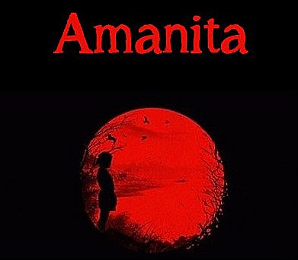
Download the Amanita eBook (PDF)
Or Read it Online
Chapter 2 – The Curse

Slide 2
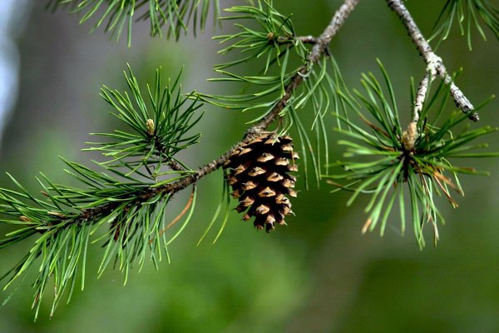
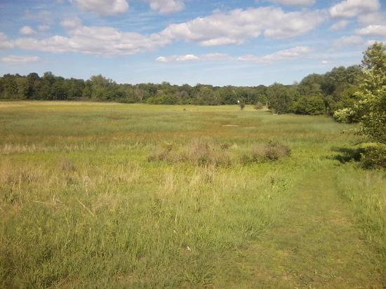
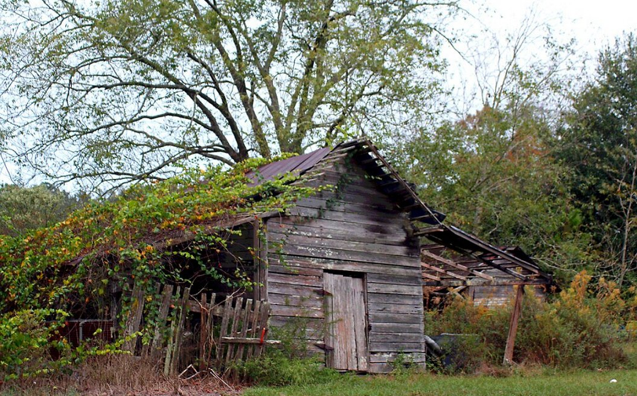
Chapter 2 – The Curse
Let’s begin by making sure we know the meaning of some important key words from the chapter.
  Page 6:
decrepit (adj)
foul (adj)
stench (n)
erupt (v)
shrieky (adj)
hysterical (adj)
tone (n)
snoop (v)
  Page 6:
hideous (adj)
whence (adv/conj.)
out-of-bounds (adj)
kinfolk (n)
bout (n)
hindrance (n)
spooked (adj)
hellcat (n)
  Page 4:
concealed (adj)
chirp (n)
echo (v)
cacophony (n)
pine cone (n)
venture (v)
  Page 5:
prairie (n)
shack (n)
makeshift (adj)
curious (adj)
premises (n)
lair (n)
Notes:
10-14 min.

Slide 3
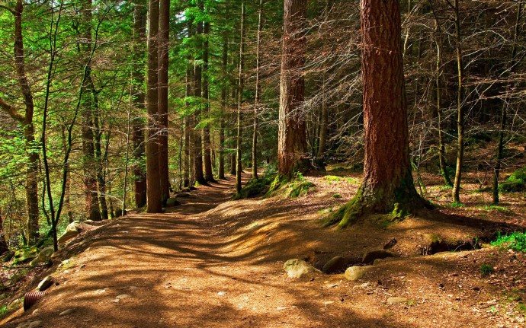
Chapter 2 – The Curse
  Sensory Description
On p. 4 there is a passage that is highly descriptive of the environment in which Amanita finds herself in.
Read the passage aloud
What does cacophony mean?
Which of the 5 senses (sight, smell, taste, touch, hearing) does it evoke?
The forest was very much alive with a cacophony of bird and insect chirps echoing from all directions, an unmistakable scent of pine needles, and the snapping of twigs and pine cones by Amanita along the footpath.
Notes:
5-7 min.
ANSWER:
Hearing: chirps and echoes (bird & insects), snapping of twigs & pine cones
Smell: scent of pine needles

Slide 4
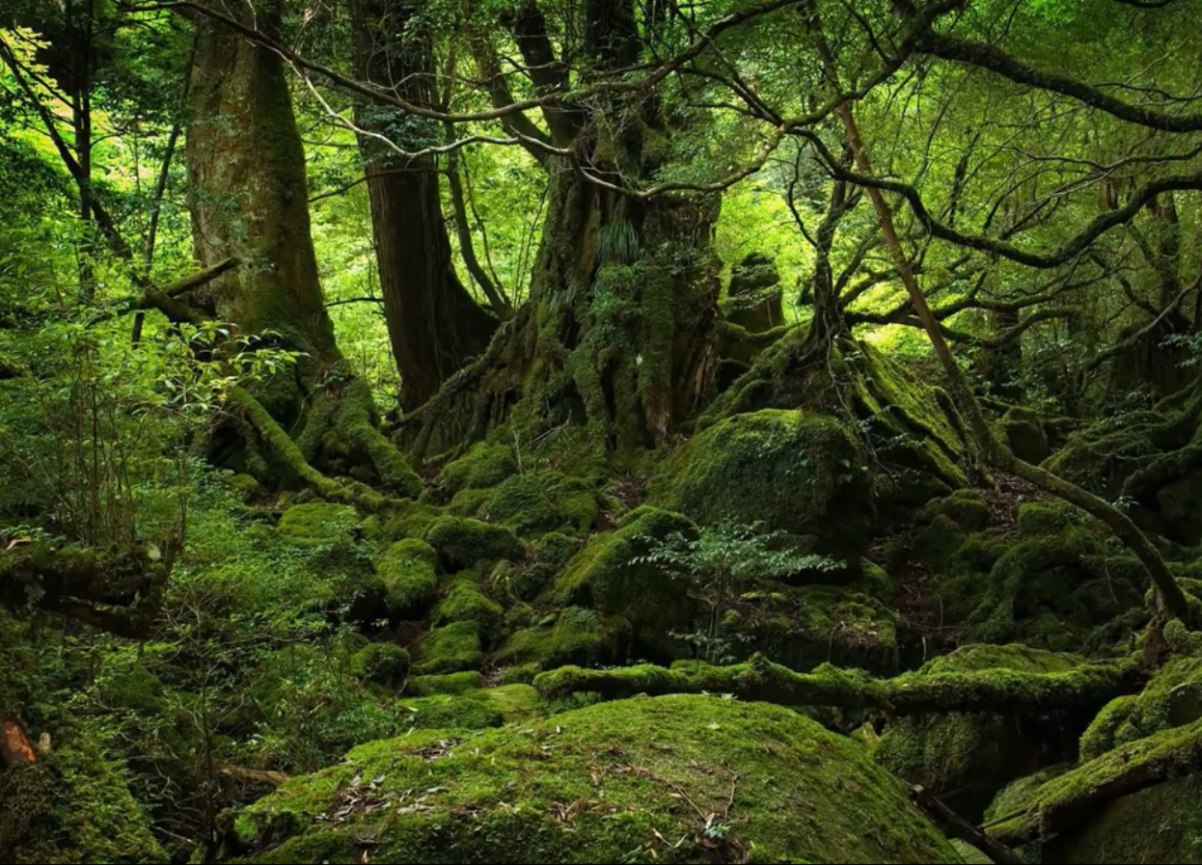
Chapter 2 – The Curse
  Setting – Tuatara Pine Forest
The setting in the first half of chapter two takes place in a forest.
Have you ever ventured alone or with others in a forest? If so, what was the experience like?
Can forests be strange and scary places to be? Why?
There is mention of a mysterious lake called Uraeus Lake, (Snake Lake) located somewhere in the Tuatara Pine Forest. What do you think could be special about this place?
Let’s watch a video called ‘5 Extremely Creepy & Haunted Forests’ to explore some of the strangest forests on earth…
Which of the 5 forests did you find the creepiest?
Notes:
20 min.
- Video: Top5s - 5 Extremely Creepy & Haunted Forests, 12:20
https://v.youku.com/v_show/id_XNDY3MTI0NDI0MA==.html
https://www.youtube.com/watch?v=vangkQyuoko
Pharaoh’s curse (my former students): 5 min.
https://v.youku.com/v_show/id_XNDcwMjYwNjUwNA==.html

Slide 5
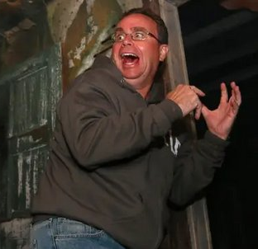
Chapter 2 – The Curse
DISCUSSION QUESTIONS:
One the concealed path of the forest, Amanita ‘felt at peace’ in this environment.
a) Why do you think she felt at peace there?
b) In which environment do you feel at peace?
When Amanita explores the old hag’s lair, she gets surprised by the hellcat who scares her ‘out of her wits’ (p. 6)
- Did you ever get scared or spooked ‘out of your wits’?
How and where?
Notes:
6-8 min.

Slide 6
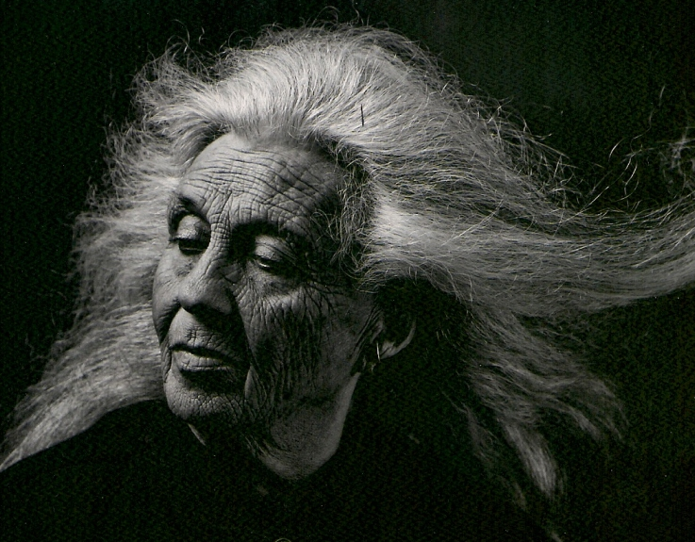
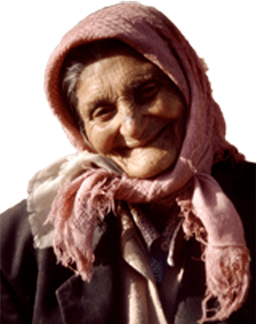
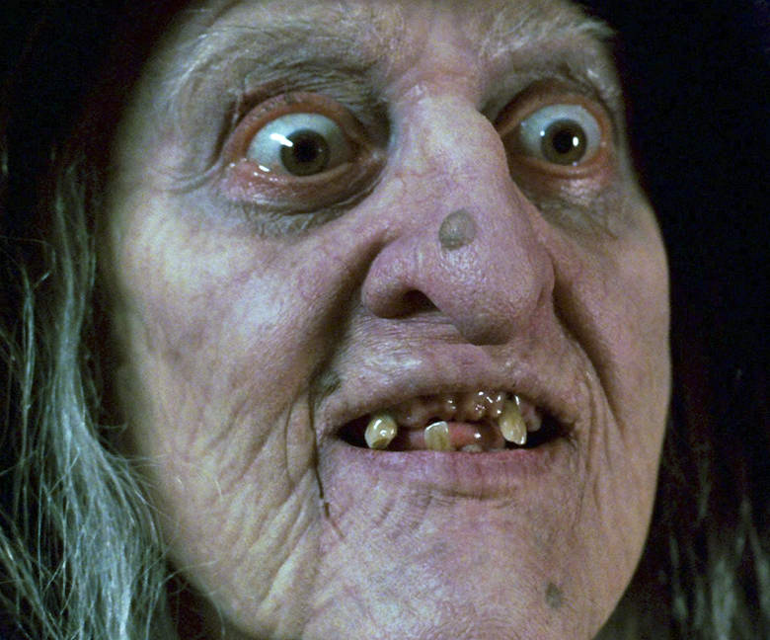
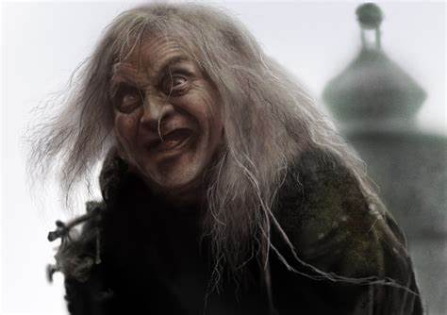
Chapter 2 – The Curse
  Characterization – Old hag / Hellcat
Amanita is confronted by a scary-looking old hag.
Which of the following do you think could be represent her?
& why?
Notes:
5-6 min.

Slide 7
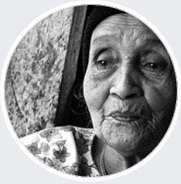


Chapter 2 – The Curse
  The Curse
- All the way back to the Ancient World, peoples such as the Mesopotamians and Hebrews knew about the power words can have.
- According to Amira Asmodea, a self-proclaimed witch from Brazil, author of Rituals and Magic:
Cursing is condemning someone to misery, misfortune and destruction.
Every curse comes from the evil energies that inhabit the earth.
Good or good-hearted people, souls, and spirits cannot be cursed, and it ends up giving the return two and even three times more powerful to the person who desires or invokes it.
Notes:
10 min.
Rituals of Magic (Amira Asmodea from Brazil)
http://rituals-magic.blogspot.com/p/finding-good-and-authentic-spell-caster.html
About: http://black-witchery.blogspot.com/2012/11/magic-and-witchcraft-asmodea.html
How to curse a person, http://rituals-magic.blogspot.com/2019/11/how-to-curse-person.html
Article - Exorcist Warns Witches that Casting Spells Will Come Back to Haunt Them
https://www.ncregister.com/blog/armstrong/exorcist-warns-witches-that-casting-spells-will-come-back-to-haunt-them
Spells in Latin (video): https://www.youtube.com/watch?v=67qQG-8AvGM

Slide 8
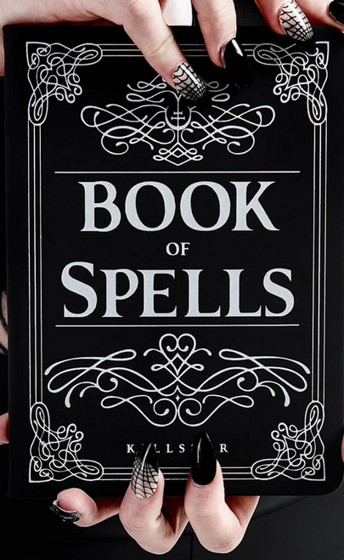
Chapter 2 – The Curse
  Spells & Incantations
A similar concept to curses are called spells or incantations.
Spells are spoken words that are thought to have magical power.
Incantations are a series of words said as a magic spell.
They can be used for good or bad.
They can be used to change the weather, bring love or misery to people,
change one’s luck, bring money and fortune, bewitch someone, attract
or seduce someone, acquire power or wealth, and attract or deter
ghosts or spirits.
They can be spoken in any language, but when invoked in Latin they are
at their most powerful.
Notes:
5 min.

Slide 9
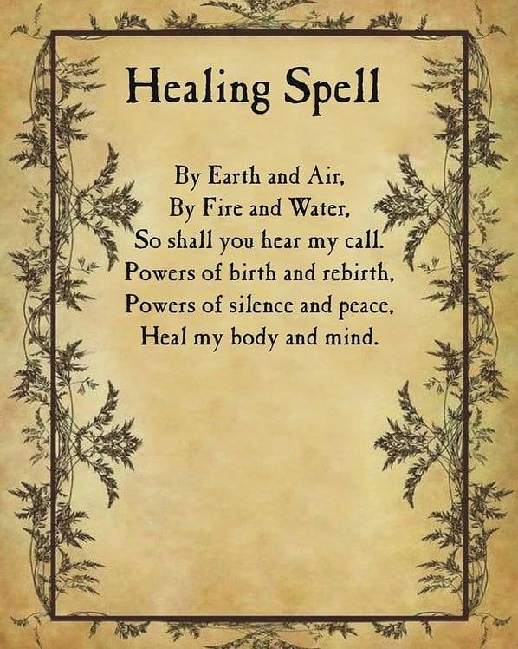
Chapter 2 – The Curse
  Spells & Incantations - example
  Here is a spell for Healing.
Notes:
5 min.
- Note, I would change the end of the spell to “Heal my body, mind, and spirit.”
- And the spell should be spoken three times (one for each of these and the Holy Trinity)
- Plus, see Howcast – How to Cast a Healing Spell, https://www.youtube.com/watch?v=kHjfvclfPIA

Slide 10
Chapter 2 – The Curse
  Spells & Incantations - example
Here is an incantation in Latin for Love.
Attract to your life the love you’re looking for. Clear your mind and think about
a person you want to attract. Say aloud:
    “I nunc amit me te amare simul (Name) quoque sicerit in me ex caritate.”
Here is an old spell to heal in Latin.
This spell is for minor heals, like small cuts, bruises or small scratches.
Say these words out loud and close to the person who has the wound:
    “Tui gratia Iovis gratia sit cures.”
Notes:
5 min.
Source: http://rituals-magic.blogspot.com/2015/04/spells-in-latin.html

Slide 11
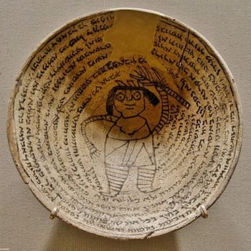
Chapter 2 – The Curse
  Incantation Bowl
In Ancient Mesopotamia, Israel, and the Middle East, people used Incantation Bowls for various purposes.
Some were to help cure their children from disease, others to ward off evil demons.
The incantation text was written in a circular fashion inside the bowl starting at the bottom all the way to the top rim.
Sometimes, a drawing a figure in the middle of the bow could help strengthen the incantation.
On occasion, a God, angel or spirit could be called upon to make the incantation even stronger.
Incantation bowl with an Aramaic inscription around a demon. From Nippur, Mesopotamia 6th–7th CE (late antique Babylonia)
Notes:
4-6 min.
Source: http://thegemara.com/naming-demons-the-aramaic-incantation-bowls-and-gittin/
Resources:
OccultWorld – Incantation bowl
http://occult-world.com/demonology-glossary/incantation-bowl/
Biblical Archaeological Society – Word Play: The power of the written word in ancient Israel
https://www.biblicalarchaeology.org/daily/biblical-artifacts/artifacts-and-the-bible/word-play/
Biblical Archaeological Society – Bible Artifacts Found Outside the Trench: Magic Incantation Bowls
https://www.biblicalarchaeology.org/daily/biblical-artifacts/magic-incantation-bowls/
Aeon: Magic bowls of antiquity
https://aeon.co/essays/what-should-be-done-with-the-magic-bowls-of-jewish-babylonia
Jewish Aramaic Incantation Bowls
https://jnjr.div.ed.ac.uk/primary-sources/biblical/jewish-aramaic-incantation-bowls/

Slide 12
Chapter 2 – The Curse
TASK: Make your own Incantation Bowl
Follow the instructions on the worksheet to write and craft your very own Incantation Bowl.
You incantation can be for any purpose: love, luck, success, to repel evil, or whatever.
Notes:
Rest of class, or as Homework

