Slide 1
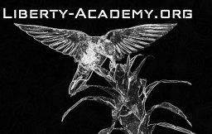
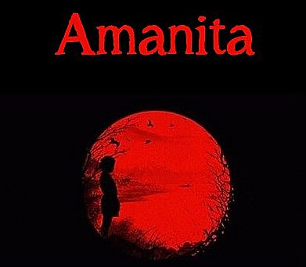
Download the Amanita eBook (PDF)
Or Read it Online
Chapter 3 – The Boar

Slide 2
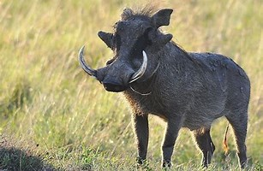
Chapter 3 – The Boar
Let’s begin by making sure we know the meaning of some important key words from the chapter.
  Page 7:
strategize (adj)
outsmart (v)
anchor (v)
façade (n)
predator (n)
  Page 7:
trek (v)
grunt (v)
tusk (n)
elongated (adj.)
snout (n)
boar (n)
tread (trodding) (v)
  Page 8:
piercing (adj.)
screech (n)
arduously (adv.)
clamber (v)
toil (n)
pause (n)
shelter (n)
belly (n)
refuge (n)
Notes:
15-20 min.
- tread (trodding is the present participle): to beat or press with the feet/ to put your foot on something or to press something down with your foot
- anchor: to secure firmly.
- façade: the front of a building or place.
- piercing: (of a sound) high, loud, and unpleasant.
- screech (n): a long, loud, high noise that is unpleasant to hear.
- belly: middle/inside part of some place.

Slide 3
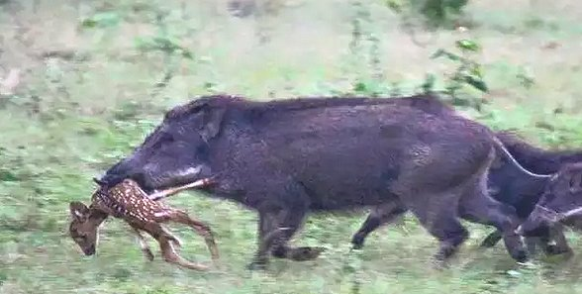
Chapter 3 – The Boar
Predator: an animal that hunts, kills, and eats other animals (or humans). People can sometimes also be seen as predators.
Prey: an animal that is hunted and killed for food by another animal.
DISCUSSION QUESTIONS:
Have you ever seen a wild boar before?
What dangers could this predator pose to others?
Have you ever been chased by an animal or someone before?
If so, what was the situation? Were you able to escape?
A wild boar (predator) snatches a deer (prey).
Notes:
8-10 min.

Slide 4
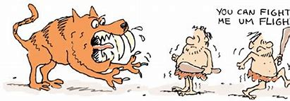
Chapter 3 – The Boar
Flight or Fight
Fight or flight is a survival instinct that human beings have.
  instinct: the way people or animals naturally react or behave,
  without having to think or learn about it.
It is believed to be “programmed” into our brains so that we instinctively (naturally) know what to do in a dangerous situation
Notes:
15 min.

Slide 5
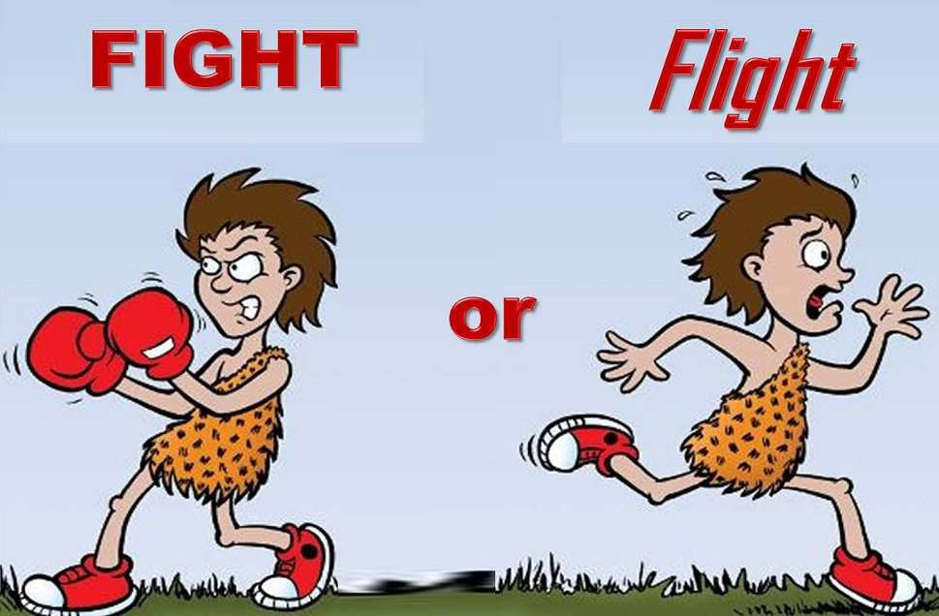
Flight or Fight
Fight means that we confront (face) our threat (dangerous animal or person) and try to stop it from hurting us in whatever way we can.
  We can kick, punch, scratch, poke, pull, or do whatever possible to defend ourselves so that we don’t get hurt, injured, or killed.
Flight means that our instinct is telling us that staying put to fight is not a good choice; and we have a much better chance at survival if we run away from the predator (or situation) as quickly as possible.
Notes:
3-4 min.

Slide 6
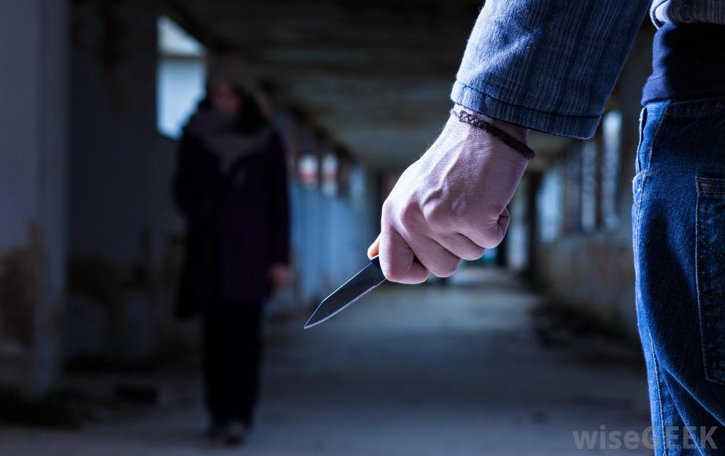
Flight or Fight
?
Notes:
3-4 min.

Slide 7
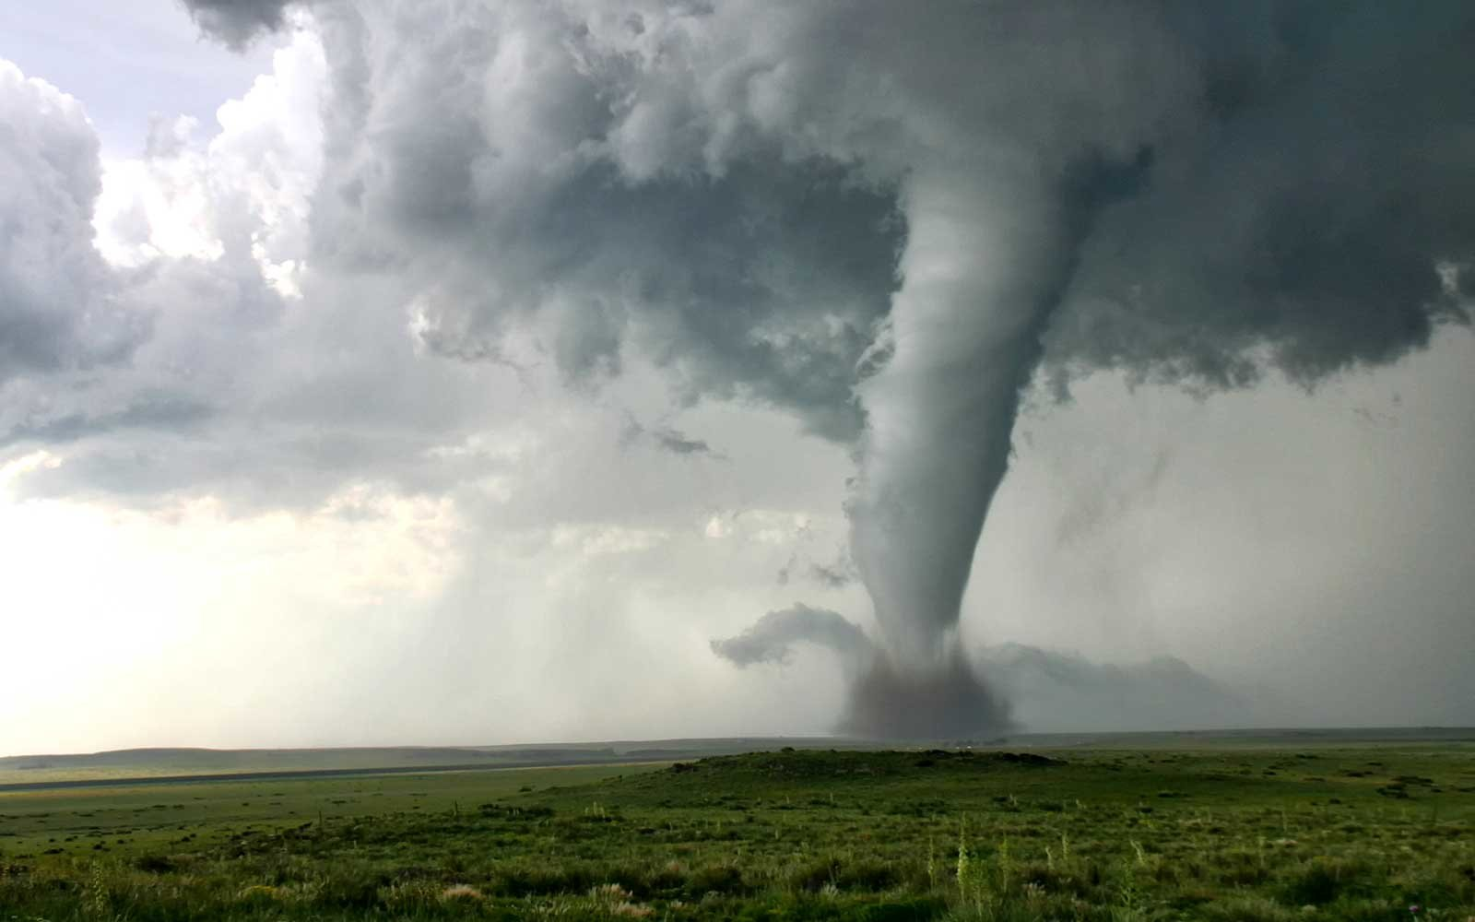
Flight or Fight
?
Notes:
3-4 min.

Slide 8
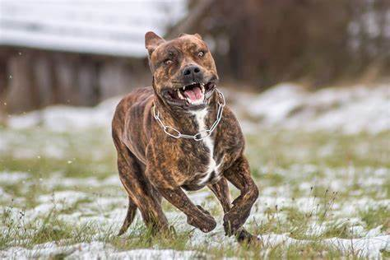
Flight or Fight
?
Notes:
3-4 min.

Slide 9
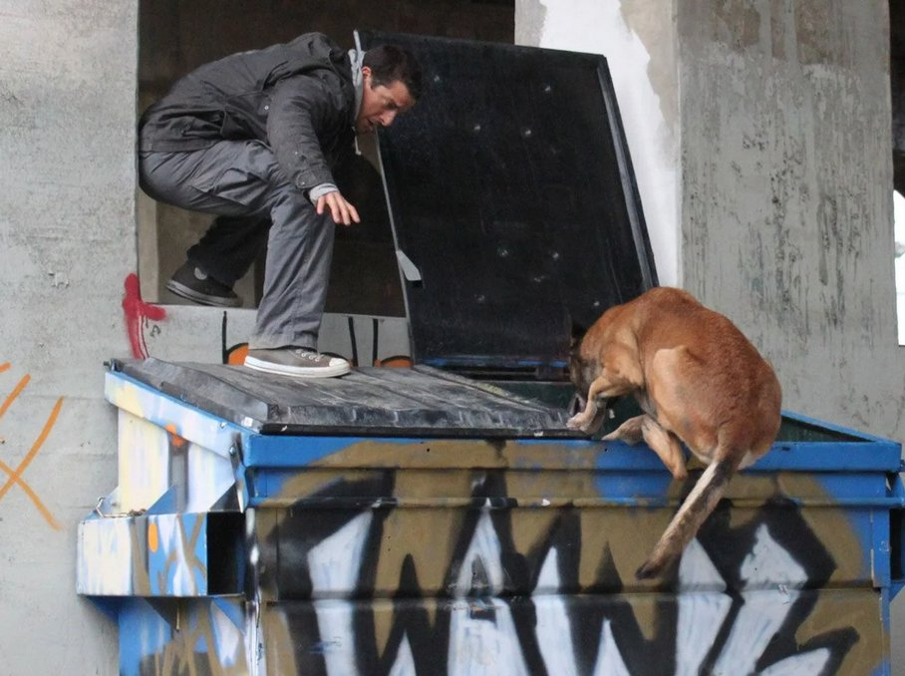
Flight or Fight
Dog Attack
Video (6:06): Let’s hear from survival expert Bear Grylls on what you should do
(and not to)…
Notes:
8-10 min.
Video - Worst Case Scenario:Downed Power Line|Dog Attack (2/2)
https://www.youtube.com/watch?v=37hBDw946k4
Article – GQ – How to survive a dog attack
https://www.gq-magazine.co.uk/article/dog-attack
https://www.beargrylls.com/pages/television-worst-case-scenario

Slide 10
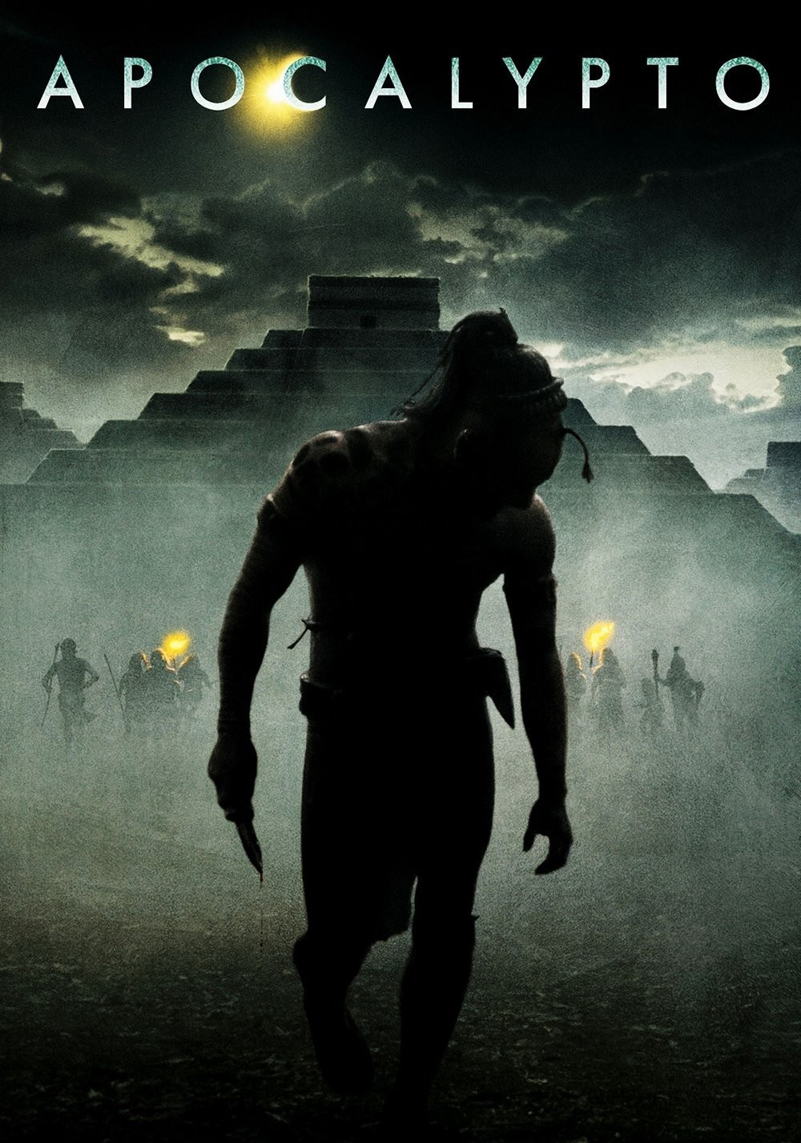
Flight or Fight
In the movies…
Apocalypto (2006): During the Mayan kingdom, a young man – Jaguar Paw – is captured as a slave and later escapes to return to his family.
The movie has many exciting fight and flight (chase) scenes, we will look at two:
  Escape from slavery scene (4:52)
  Waterfall scene (4:26)
Notes:
10-12 min.
Video clip #1 ‘Escape from Slavery scene’ (4:52)
https://www.youtube.com/watch?v=0tb-0KMG-zU
Video clip #2 ‘Waterfall scene’ (4:26)
https://www.youtube.com/watch?v=OFndFA1ipiw
IMDB – Apocalypto (2006)
https://www.imdb.com/name/nm2199632/?ref_=tt_cl_t1

Slide 11
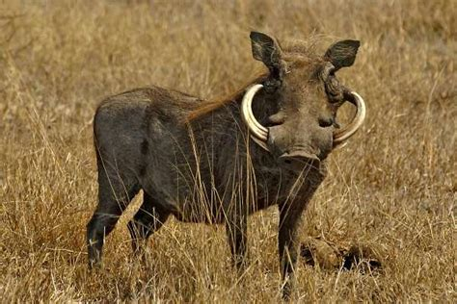
Chapter 3 – The Boar
Flight or Fight
DISCUSSION QUESTIONS:
How does Amanita respond when being chased by the wild boar?
What did her instincts lead her to do?
Why do you think she was successful in getting out of this very dangerous situation?
What could she have done if there were no cliff to climb up on?
What would you do if confronted by a wild boar?
Notes:
15 min.

Slide 12
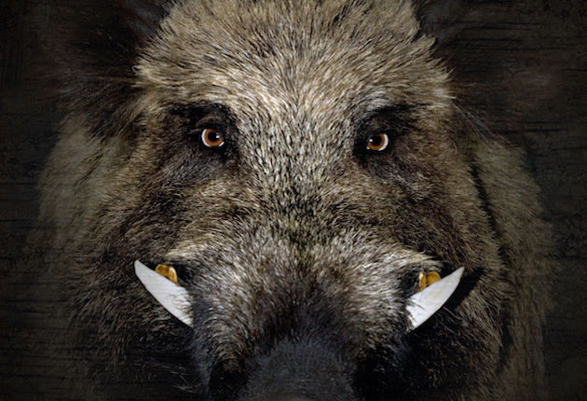
Chapter 3 – The Boar
Flight or Fight
ARTICLE – How to Survive a Wild Boar Attack | All You Need to Know
Read the section ‘When do they attack humans?’
And the section ‘How to Survive a Wild Boar Attack And what to do’
What were 3 tips mentioned in the article about what you can do?
  slowly back away; reach higher ground;
  sidestep if you need to run; keep standing position
Notes:
15 min.
Tips: - slowly back away; - reach higher ground; - sidestep if you need to run (to avoid the boar trying to trip you); - keep standing position
How to Survive a Wild Boar Attack | All You Need to Know
https://restlessbackpacker.com/how-to-survive-a-wild-boar-attack/

Slide 13

Chapter 3 – The Boar
Dilemma
Having just escape from the wild boar Amanita had just started to climb a rocky cliff.
Though she hit the boar between the eyes with a rock, it was still there waiting for her.
She was now in a dilemma.
A dilemma is a difficult situation in which you have to choose between two choices which are both undesirable or unpleasant.
Once at the bottom of the cliff (after she threw a rock at the boar) Amanita can either:
  Climb up the very high and dangerous cliff where she could fall, or
  Go back down and face the angry wild boar.
  (both have risks of injury and can even be fatal!)
Notes:
3-4 min.

Slide 14
Chapter 3 – The Boar
Dilemma
DISCUSSION QUESTIONS:
Have you ever had a dilemma before? Explain.
DECISION MAKING:
How do you usually go about making difficult decisions?
CASE (dilemma):
Your best friend just got caught by the teacher cheating on a test and told him that you are the one who gave her the cheat sheet. She lied. What do you do?
Notes:
3-4 min.

