Slide 1

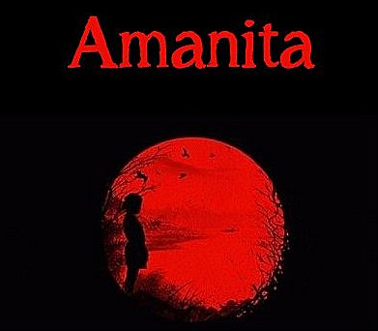
Download the Amanita eBook (PDF)
Or Read it Online
Chapter 4 – The Cave

Slide 2
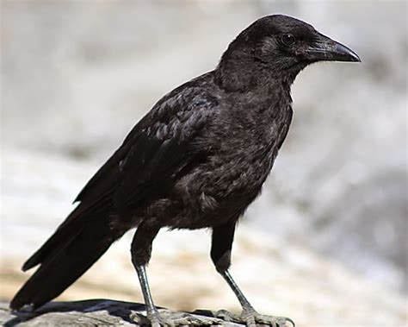
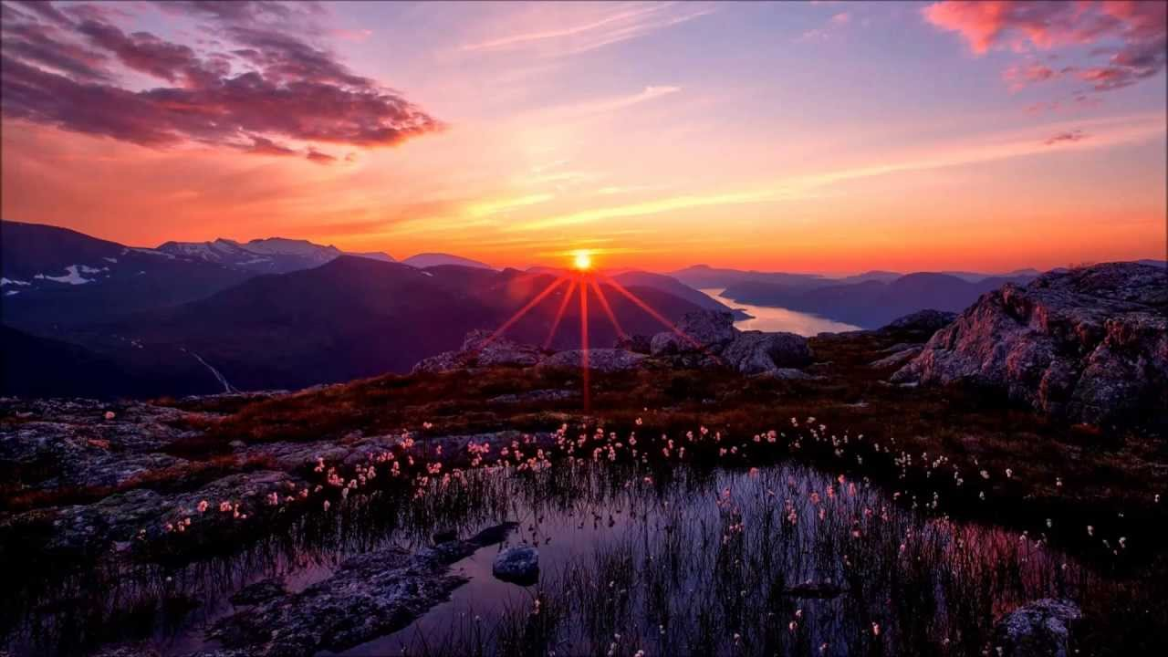
Chapter 4 – The Cave
Let’s begin by making sure we know the meaning of some important key words from the chapter.
  Page 9:
scarce (adj.)
illuminate (v)
disoriented (adj.)
pivot (v)
strenuous (adj.)
  Page 10:
slumber (n)
maiden (n)
heighten (v)
flicker (v)
emanate (v)
surmise (v)
slither (v)
induce (v)
idle (adj.)
provoke (v)
ascent (n)
  Page 11:
crow (n)
caw (n)
perch (v)
porcelain (n)
ballerina (n)
strike (v)
crank (n)
flutter (v)
perceive (v)
horizon (n)
Notes:
12 min.
- tread (trodding is the present participle): to beat or press with the feet/ to put your foot on something or to press something down with your foot
- anchor: to secure firmly.
- façade: the front of a building or place.
- piercing: (of a sound) high, loud, and unpleasant.
- screech (n): a long, loud, high noise that is unpleasant to hear.
- belly: middle/inside part of some place.

Slide 3
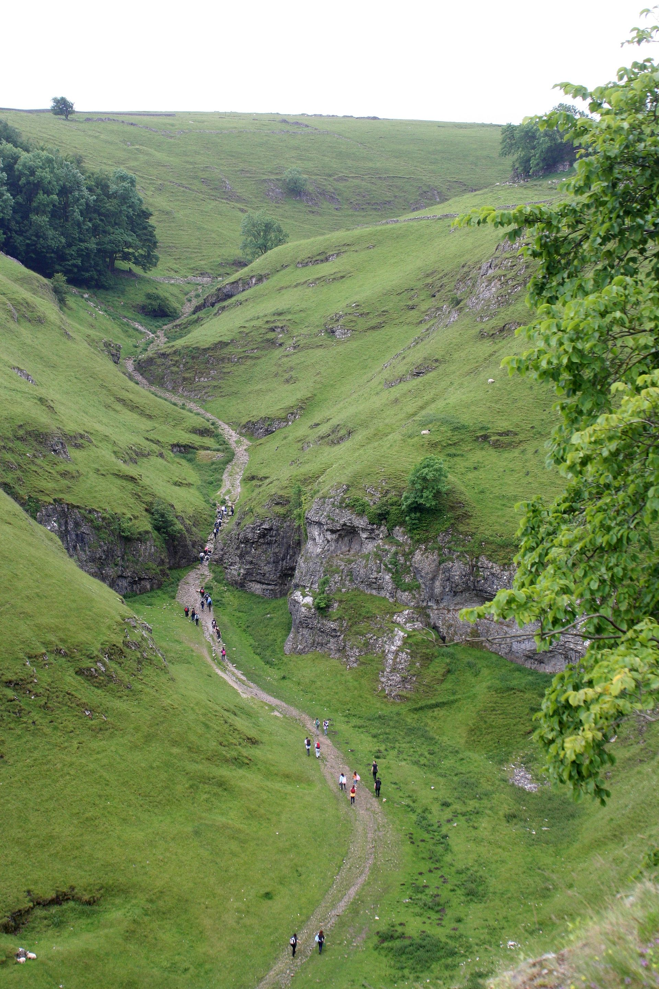
Chapter 4 – The Cave
Let’s begin by making sure we know the meaning of some important key words from the chapter.
  Page 12 (cont’d):
perilous (adj.)
crow (n)
drift (v)
hint (n)
speculate (v)
retort (v)
opt (v)
  Page 13:
boulder (n)
wound (v)
sting (v)
deduce (v)
parched (adj.)
suitably (adv.)
frail (adj.)
state (n)
scantily (adv.)
valley (n)
cramp up (v)
pace (n)
  Page 12:
mound (n)
stroke of luck (exp.)
emerge (v)
discernible (adj.)
ridge (n)
descent (n)
trot (v)
fortunate (adj.)
lingering (adj.)
Notes:
12-15 min.
- tread (trodding is the present participle): to beat or press with the feet/ to put your foot on something or to press something down with your foot
- anchor: to secure firmly.
- façade: the front of a building or place.
- piercing: (of a sound) high, loud, and unpleasant.
- screech (n): a long, loud, high noise that is unpleasant to hear.
- belly: middle/inside part of some place.

Slide 4
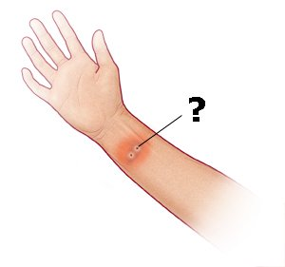
Chapter 4 – The Cave
Stricken
On pages 12-13 we can find the following passage:
Still, at that particular moment she started to feel quite dizzy and short of breath. The troubled girl sat on a large boulder to regain her senses and noticed two red marks on her right wrist. The small narrow wounds seemed quite fresh but she couldn’t recall falling down or being stung by anything. “Something is definitely not right,” she deduced. Additionally, her throat was becoming very parched and she was awfully thirsty.
How was she feeling?
What do you think bit or hurt her?
What were her symptoms?
What does “to regain here senses” mean?
Notes:
10-12 min.
- Symptoms Amanita exhibits (4): dizziness (dizzy), short of breath, dry/parched throat, thirsty.
Definition:
symptom: A symptom of an illness is something wrong with your body or mind that is a sign of the illness. – Collins
An indication of a disorder or disease, especially a subjective one such as pain, nausea, or weakness. – American Heritage

Slide 5
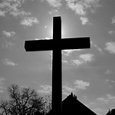

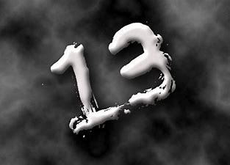
Symbolism
symbolism: the use of ​symbols in ​art, ​literature, ​movies, etc. to ​represent ​ideas. (Cambridge Online Dictionary)
Symbolism is used (indirectly) to reinforce an idea, message, or theme the author wants to emphasize.
Symbolism can be found in:
  things you can touch (objects) ex.: a cross
  colors ex.: red can symbolize blood/sacrifice
  things you can’t touch (love, emotions, beliefs, …)
  sounds / music
  numbers (lucky, unlucky)
  ex.: 13 is unlucky in many cultures
‘symbolize’ is the verb we use to express symbolism
about something.
Notes:
5-7 min.
Examples: black cat → bad luck, 13 = unlucky, 8 = lucky (in China)

Slide 6
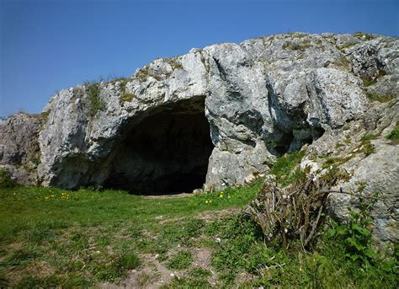
Symbolism
In this chapter, the following four things are considered to have symbolism:
1. What can does the cave symbolize?
2. Questions:
Why was the cave useful to Amanita?
What creature do you think Amanita encountered in the cave? Why?
How did she manage to keep calm?
The Cave
Notes:
3-5 min.
SUGGESTED ANSWER: uncertainty, the unknown, darkness, dangers of society/strangers, our subconscious / lower-self

Slide 7
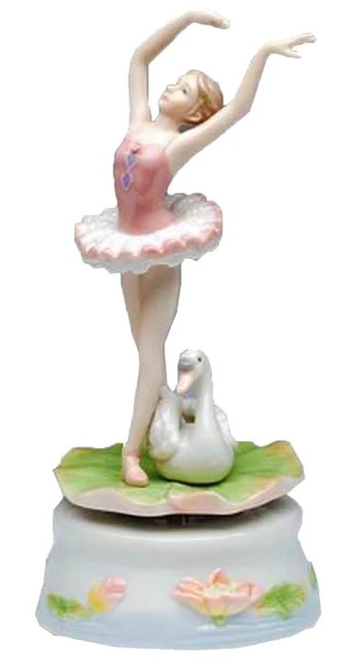
Symbolism
Questions:
Why does the ballerina represent?
What does the white swan represent?
Why do you think the ballerina figure broke into many pieces but the white swan remained intact (unbroken) when it fell from the dresser?
The porcelain Ballerina
& White Swan Music Box
Notes:
4-8 min.
SUGGESTED ANSWER: a) i.) ballerina → Amanita herself, the broken pieces can represent her broken self and her problems
ii.) ballerina → materialism, false ideals;
b) white swan → purity, the indestructibility of nature

Slide 8
Symbolism
In this chapter, the following four things are considered to have symbolism:
Questions:
What does the crow symbolize? Is it something good or bad?
How did the crow influence Amanita’s choice of which path to take at the base of the mountain?
The Crow
Notes:
2-3 min.
SUGGESTED ANSWER: consciousness, a guiding force, natural instinct, our ancestors

Slide 9
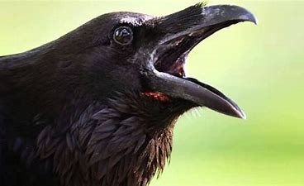
Symbolism
In this chapter, the following four things are considered to have symbolism:
Amanita hears the caw sound in her dream and later while she is walking along the path just before it forks.
Questions:
What can the caw sound symbolize in the context of this story?
The Caw
Notes:
2-3 min.
SUGGESTED ANSWER: a warning or alert, better pay attention

Slide 10
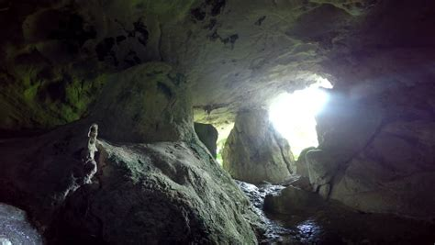
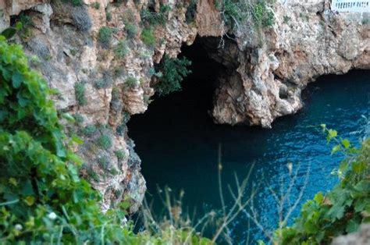
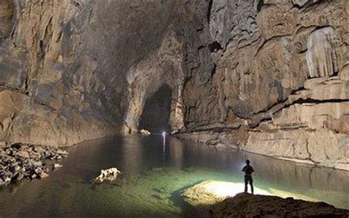
Caves
DISCUSSION QUESTIONS:
Have you ever been in a cave? Where?
How big and deep can they get?
Why are caves mysterious?
What can be found in caves?
Why can caves be scary?
Notes:
5-7 min.

Slide 11
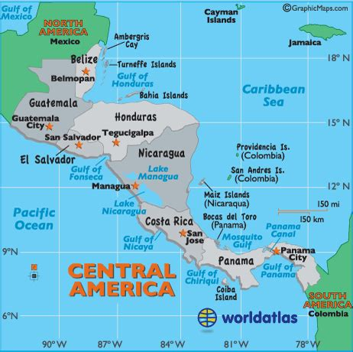
Famous Caves – ATM cave in Belize
The Crystal Maiden
There’s a cave called ‘Actun Tunichil Muknal’, or ATM located in a small country called Belize in Central America.
It contains the skeletons of people have been killed over 1000 years ago during the height of
the Mayan civilization period.
One of these skeleton’s is of the ‘Crystal Maiden’ who was about 18-20 years old.
DISCUSSION QUESTIONS:
What do you think happened to her? Who or what may have killed here and why?
Why do you think those who found her in 19xx call her the ‘Crystal Maiden’?
Notes:
5-7 min.

Slide 12
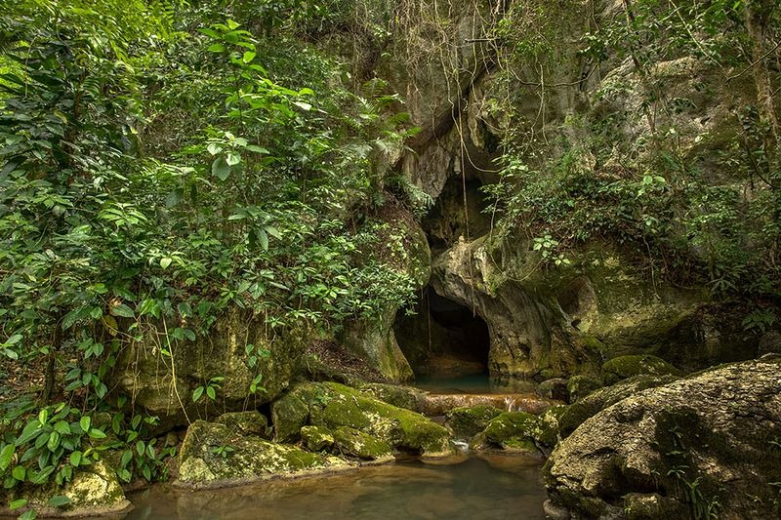
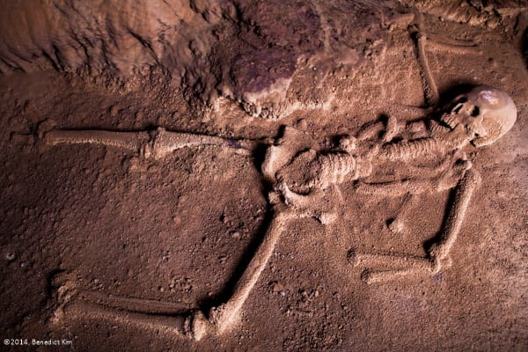
The Crystal Maiden
VIDEOS:
Let’s watch a few videos on the subject starting with one from National Geographic about the Ancient Maya.
POST-VIEWING DISCUSSION:
What did the Mayans believe caves to be?
What happened to the Crystal Maiden? How did she die and why?
What rituals did they do and why? What forms of sacrifices did they have?
Why would the Mayans sacrifice their own people – especially the young?
Entrance to the Actun Tunichil Mukual (ATM) cave in Belize
Read more about…
Skeleton of the Crystal Maiden
Notes:
25-35 min.
Article with great pictures:
AmusingPlanet.com - Actun Tunichil Muknal: The Cave of The Crystal Maiden
https://www.amusingplanet.com/2016/04/actun-tunichil-muknal-cave-of-crystal.html

