Slide 1

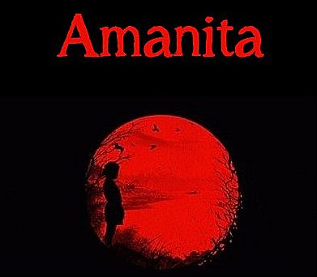
Download the Amanita eBook (PDF)
Or Read it Online
Chapter 5 – The Swarm

Slide 2
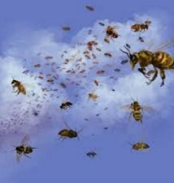
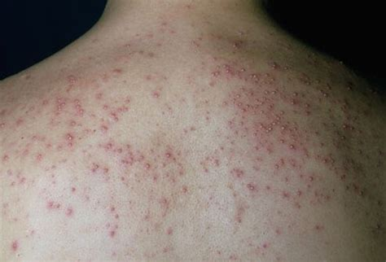
Chapter 5 – The Swarm
Let’s begin by making sure we know the meaning of some important key words from the chapter.
  Page 14:
amiss (adj.)
twinge (v)
swarm (n)
muster (v)
sting (v)
hurling (adj.)
swat (v)
frantically (adv.)
propitiously (adv.)
  Page 15:
halve (v)
gap (n)
rash (n)
excruciatingly (adv.)
collapse (v)
  Page 14:
dissipate (v)
lush (adj.)
cluster (n)
scant (adj.)
wail (v)
tempestuous (adj.)
determined (adj.)
persistent (adj.)
kindled (adj.)
Notes:
20 min.

Slide 3
Chapter 5 – The Swarm
Themes & Subjects
Let’s explore the following themes & subjects from this chapter:
Luck
Bees
Allergies
Loss of consciousness
Notes:
2 min.

Slide 4
Chapter 5 – The Swarm
Themes – Luck
DICUSSION QUESTIONS:
What is luck?
  What are synonyms for luck? What is the antonym?
Are you mostly a lucky person or an unlucky one?
Who is the luckiest person you know? How so?
What kind of life events can we attribute to luck?
What can maybe determine luck?
Can we change our luck?
Notes:
10-13 min.
- What is luck? A force that brings good fortune or adversity. – Merriam-Webster
- synonyms: chance, fortune, karma; antonym: unlucky, luckless, misfortune, afflicted
- life events: meeting one’s soulmate; marriage; children, winning the lottery,

Slide 5
Themes – Luck
According to Merriam-Webster dictionary, luck is a force that brings good fortune or adversity.
Since ‘force’ is some kind of power or energy, we can perhaps view luck as a form of ‘good energy’ (lucky) or ‘bad energy’ (unlucky).
According to the Popular Science article ‘The Science Of Luck’ and a professor of psychology at the University of Hertfordshire in England, Richard Wiseman:
  "unlucky" people seemed to demonstrate more anxiety (and are more uptight, nervous, and closed-off); while
  “lucky” people are more observant and open to random opportunities.
Notes:
3-4 min.
Popular Science - The Science Of Luck, https://www.popsci.com/luck-real/
Extra Newsweek article: https://web.archive.org/web/20090321192238/https://www.newsweek.com/id/181290/output/print

Slide 6
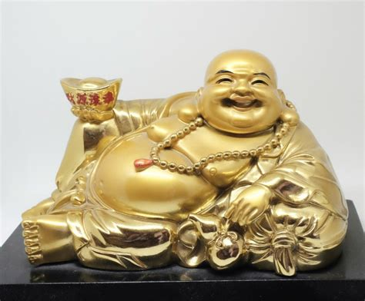
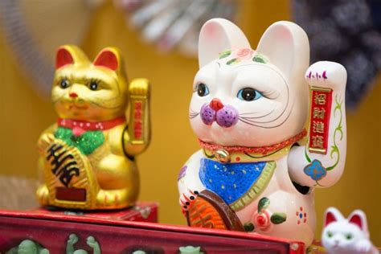
Themes – Luck
Good Luck Charms
A charm is an object or saying that is thought to have magical powers, such as the ability to bring good luck – Cambridge Dictionary.
Good luck charms vary across different cultures.
Here are some common ones from around the word (think about why):
ASIA:
Laughing Buddha (Thailand & India)
Maneki –Neko (Japan)
Notes:
4-5 min.
*** 24 Good Luck Charms from Around the World, https://www.invaluable.com/blog/good-luck-charms/
** Good Luck Symbols in Different Cultures, https://www.daytranslations.com/blog/good-luck-symbols-different-cultures/
https://www.migrationtranslators.com.au/good-luck-symbols-in-different-cultures/
ASIA:
- Maneki-Neko: The Japanese phrase “Maneki Neko” is literally translated to mean “beckoning cat.” (click link for origin/story)
witandfolly.co/maneki-neko
Laughing Buddha: To bring you luck, you have to keep a positive attitude and rub the Buddha’s stomach every day.

Slide 7
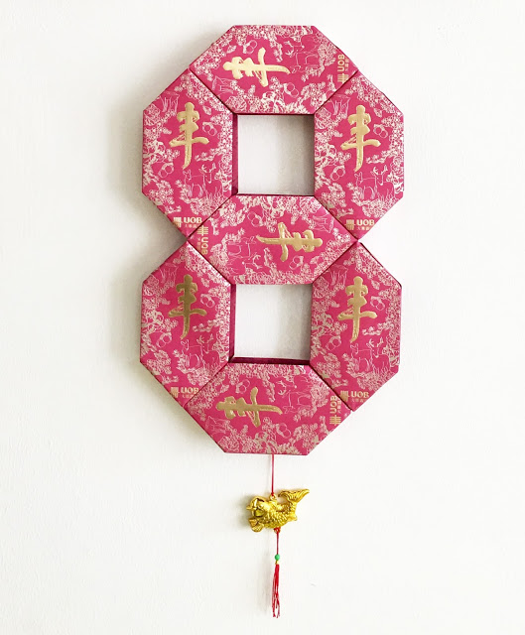
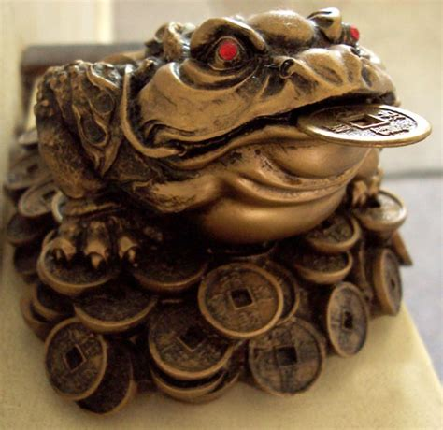
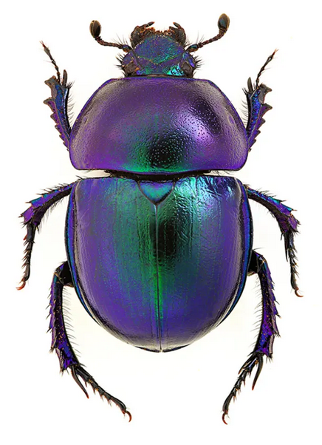
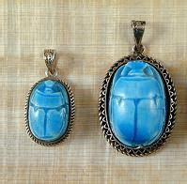
Good Luck Charms
ASIA:
Jin Chan - golden toad
(China)
Number 8
(China)
Middle East:
Scarab Beetle Amulet
(Egypt)
An amulet is a kind of charm worn because it is believed to protect against evil, disease, or unhappiness.
Notes:
6-7 min.
MIDDLE EAST:
Scarab Beetle Amulet: It symbolized rebirth and regeneration, and was believed to provide protection from evil.

Slide 8
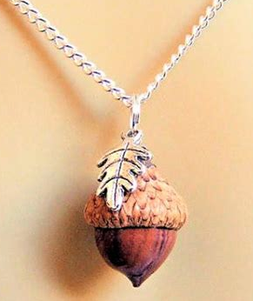
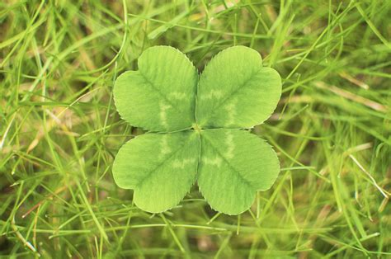
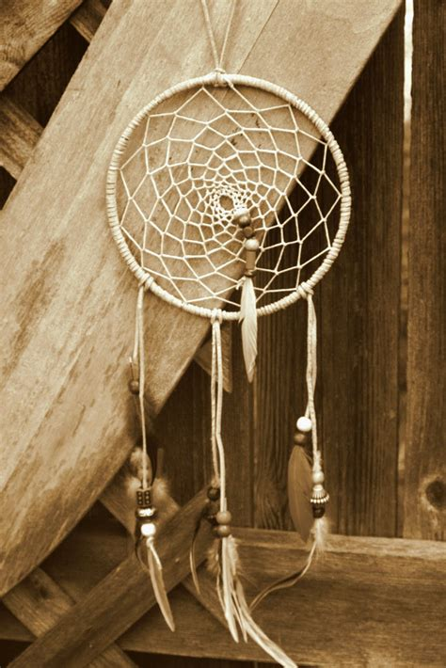

Good Luck Charms
EUROPE:
Acorns
(England)
Four-leaf clover
(Ireland)
NORTH AMERICA:
Dream catcher
(United States
– Native Americans)
Horseshoe
(United States)
Notes:
6-7 min.
EUROPE:
Acorns: Long before acorns were considered good luck, they were associated with magic between two witches. When passing each other in the woods, witches would hand each other acorns to let one another know who they were and that they were safe in one another’s company. As a good luck symbol, acorns are said to protect one’s health. Carrying an acorn is believed to protect from illnesses, aches, and other pains. If you’re already ill, it is said to speed up the healing process and alleviate any pain.
NORTH AMERICA:
Horseshoe (USA): the superstitious believe that hanging a horseshoe over your door will bring your home protection and good luck.
Dream catcher: the Chippewa Native American dream catcher is used for those with trouble sleeping, specifically those with nightmares. When the person is asleep, the dreamcatcher is said to trap all the nightmares of the sleeper, to bestow good luck, and allow good dreams to flow freely. Legend has it that when the sun rises, the bad dreams caught in the dream catcher dissolve, as they cannot survive daylight. The Chippewa, or Ojibwa, Native Americans designed these dream catchers to help protect their children. The tradition is associated with the Asibikaashi, or Spider Woman, a woman from Ojibwa legend who was a caretaker of all children.

Slide 9
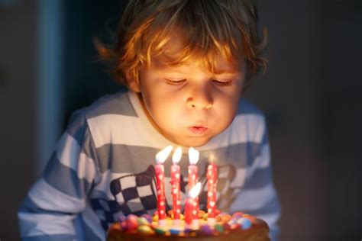
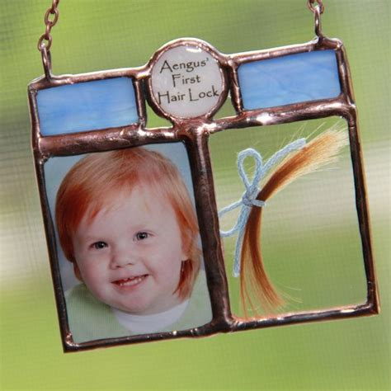
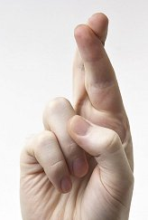
Themes – Luck
Good Luck Rituals
A ritual is a set of actions performed for a specific ceremony or purpose.
Here are some common ones from around the word:
Cut a lock of baby’s first hair
Blowing out birthday candles on a cake
Cross fingers
Notes:
4 min.
Rituals:
https://goodlucksymbols.blogspot.com/p/good-luck-rituals.html
http://superstitionlane.com/luck-2/6-good-luck-rituals/
https://www.mentalfloss.com/article/79409/14-good-luck-superstitions-around-world
- Birthday candles: Blowing out the candles is an ancient worship ritual of the Greek goddess Artemis. On her birthday, they made her little cakes in the shape of a moon and the people placed candles on the temple altar. If the people could blow out the candles in one breath, Artemis would make their wish come true, bring them good luck, and watch over them.
- Cross fingers: The power of such an act dates back to the early Christians who were forced to worship in secret. While they couldn’t have representations of the cross to inspire them, they could, and did, create a reminder of Christ’s passion be making a cross of their middle and index fingers.
- Baby’s hair: From ancient times in cultures around the world, such mementos were intended to ensure a long and healthy life, as long as the lock of hair was kept in a safe place.

Slide 10
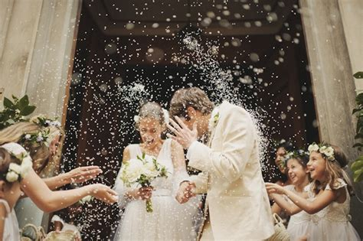
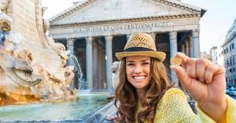
Good Luck Rituals
A ritual is a set of actions performed for a specific ceremony or purpose.
Here are some common ones from around the word:
Tossing a coin in to a fountain
Throwing rice at bride & groom at a wedding
Notes:
4 min.
- Rice shower: It comes from ancient China, where rice was a symbol of fruitfulness. In the Middle Ages, Europeans substituted wheat for rice, but the meaning was the same.
- Coin into fountain: It is a tradition that dates back to the ancient Greeks and possible even further into antiquity. The ancients believed that a gift of a little money to the gods who inhabited their wells would keep the wells from running dry.
Article - Why Do We Throw Coins in Fountains? https://greatergood.berkeley.edu/article/item/why_do_we_throw_coins_in_fountains

Slide 11
Chapter 5 – The Swarm
Themes – Allergies
DICUSSION QUESTIONS:
What are allergies?
What are some common allergies people have?
What are you allergic to?
How can one overcome an allergy?
In the story:
Amanita gets allergic reactions to what?
What does it do to her body and her mind?
Notes:
10-12 min.

Slide 12
Chapter 5 – The Swarm
Themes – Consciousness & Loss of Consciousness
DICUSSION QUESTIONS:
What is consciousness? What do we mean by the conscious mind?
What does unconscious mean?
  When are people unconscious?
  What are synonyms for it?
What does subconscious mean?
  What can lie in your subconscious?
In the story:
Amanita lies unconscious next to the river bank. What do you think will happen to her?
Notes:
20 min.
DQs 12 min.
3 Videos (9 min.)

