Slide 1
Download the Amanita eBook (PDF)
Or Read it Online
Chapter 7 – The Renewal
Part 2

Slide 2
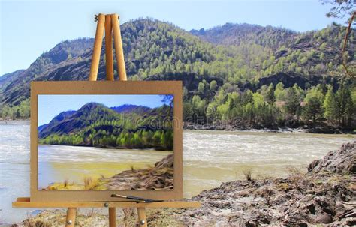
Chapter 7 – The Renewal
Let’s begin by making sure we know the meaning of some important key words from the chapter. Since this chapter has many new words, we will split them into two parts for this lesson. Here is the second part:
Page 27:
quiver (n)
excursion (n)
absence (n)
dormancy (n)
subtly (adv.)
twitch (v)
crack open (v)
radiate (v)
flicker (v)
glow (n)
roar[ing] (in the fire) (v)
Page 27 (cont’d):
hypnotic (adj.)
trance[d] (v)
slumber (n)
brilliant (adj.)
picturesque (adj.)
easel (n)
resplendent (adj.)
adorn (v)
hue (n)
carefree (adj.)
abound (v)
pollinate (v)
Notes:
20 min.

Slide 3
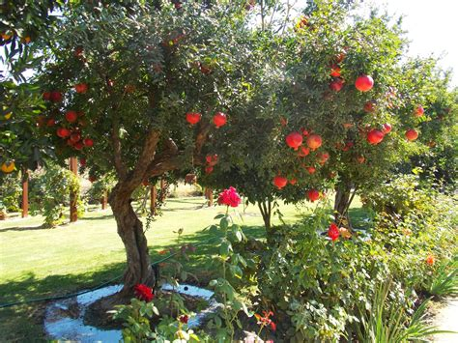
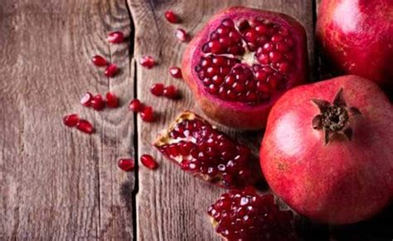
Chapter 7 – The Renewal
Let’s begin by making sure we know the meaning of some important key words from the chapter. Since this chapter has many new words, we will split them into two parts for this lesson. Here is the second part:
Page 28:
buzz[ing] (v)
struggle (v)
glow (n)
angel (n)
savor (v)
genuine (adj.)
bliss (n)
soul (n)
spring [sprang] (v)
pomegranate (n)
joyous (adj.)
gear (n)

Slide 4
Chapter 7 – The Renewal
Themes & Subjects
Let’s explore the following themes & subjects from this chapter. For Part 1 we will looked at:
Dreams
Angels
In Part 2 we will continue with:
The Future, Predicting the Future
Story Resolution & Discussion
Notes:
1 min.

Slide 5
Chapter 7 – The Renewal
Themes – The Future
Amanita’s last dream brings her into the future as an adult woman and mother to a lovely daughter called Alya.
As we explored earlier, prophetic dreams can offer a glimpse into the future, as they reveal events that will take place before they happen.
From time immemorial, people have attempted to foretell the future; a plethora of methods have been employed to do so – from gazing into crystal balls to reading tea leaves.
At times, the future can be revealed by prophets, seers, psychics, or angels.
Notes:
2-3 min.

Slide 6
Chapter 7 – The Renewal
Themes – The Future
Prophets are messengers or those who obtain knowledge about the future – its events, people, actions, and consequences. Many famous prophets are referenced in the Bible as messengers of God.
Psychics can have supernatural powers such as precognition.
Seers, sometimes called soothsayers, have the ability to see or tell the future.
Those in power such as kings and queens have employed people with these abilities to gain advantages (especially over their rivals and enemies) and to ensure their power remains secured and unthreatened.
Notes:
2-3 min.
- Mystic Files - Famous Psychics of the Past
http://www.mysticfiles.com/famous-psychics-of-the-past/
- MentalFloss - The Quick 10: 10 Famous Soothsayers
https://www.mentalfloss.com/article/24204/quick-10-10-famous-soothsayers

Slide 7
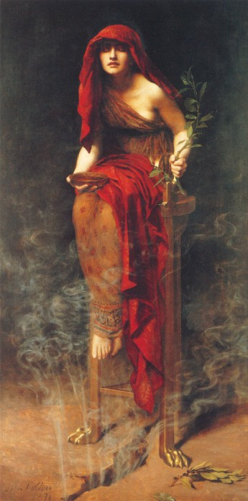
Themes – The Future
Famous Prophets, Psychics, and Seers.
Throughout the ages, there have been numerous prophets, psychics, and seers. Let’s have a look at a few.
Pythia – In Ancient Greece, Pythia (more commonly known as the Oracle at Delphi) was a high priestess, a seer, who made prophetic predictions about the future. She practiced her craft at the Temple of Apollo (in Delphi) and was often consulted by great leaders of the time.
Notes:
2-3 min.
PYTHIA:
- Women in Antiquity - The Pythia
https://womeninantiquity.wordpress.com/2017/04/01/pythia/
- Ancient Origins - Pythia: Oracle and High Priestess of Delphi
https://www.ancient-origins.net/myths-legends/pythia-oracle-delphi-001641
- ThoughCo - Pythia and the Oracle at Delphi
https://www.thoughtco.com/pythia-oracle-at-delphi-4773038

Slide 8
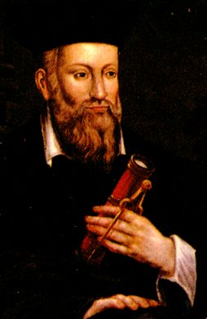
Themes – The Future
Famous Prophets, Psychics, and Seers.
Nostradamus – Michel de Nostredame (1503 - 1566), better known as Nostradamus, was a French physician, astronomer and astrologer. He is considered a prophet by many. He was instructed in a wide range of academic subjects at an early age, including traditional sciences, math, languages (Latin, Greek and Hebrew) as well as astrology. He is famous for his 1555 book of predictions entitled: “Les Prophéties” or “The Prophecies” in which he foretells hundreds of future events.
Notes:
2-3 min.
- Nostradamus 101
www.nostradamus101.com/prophecies/part1/
archived at: https://web.archive.org/web/20121101041259/www.nostradamus101.com/prophecies/part1/

Slide 9
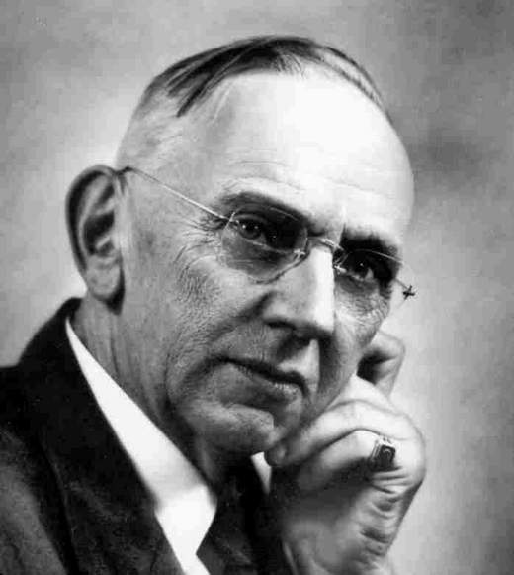
Themes – The Future
Famous Prophets, Psychics, and Seers.
Edgar Cayce, sometimes referred to as The Sleeping Prophet, was a renowned American psychic that lived in the 20th century. He was a devout Christian who made thousands of predictions and helped people who were desperate to know more about their health, dreams, and futures. Some of his predictions include: the stock market crash of 1929 (the Great Depression) and a 1935 prediction about World War II. But not all of his predictions happened.
Notes:
2-3 min.
EDGAR CAYCE:
https://www.edgarcayce.org/edgar-cayce/his-life/
https://www.noracaron.ca/edgar-cayces-prophecies-of-the-future-of-earth/

Slide 10
Themes – The Future
Famous Prophets, Psychics, and Seers.
→ Their Methods ←
How did they do it?
These gifted people use different methods to predict the future; some may use objects and/or specific rituals to assist them, while others simply use their supernatural abilities.
Some may even receive help from supernatural beings such as angels, gods, or deities. This kind is often referred to as divination (from Latin divinare which means ‘predict’, and ‘divine’ which means from God, a god).
Notes:
1 min.

Slide 11
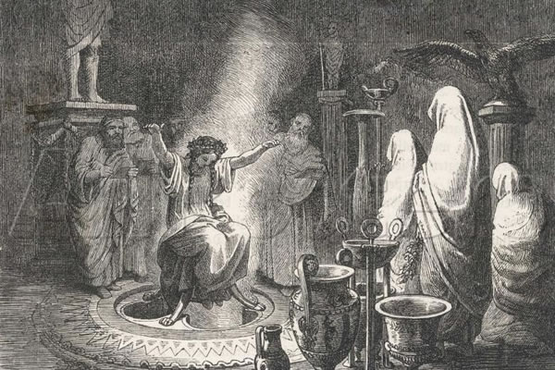
Themes – The Future
Famous Prophets, Psychics, and Seers.
→ Their Methods ←
Pythia: watch the following two videos and listen for the methods Pythia used:
Rick Steeve’s - Delphi, Greece (for background on the site of the oracle and Pythia’s method)
See U in History - Mythological Curiosities - The Oracle of Delphi - The Temple of Apollo (for more historical information and Pythia’s methods)
Read more:
Ancient-Origins.net – Pythia: Oracle and High Priestess of Delphi
Women in Antiquity – The Pythia
Notes:
15-20 min.
Show info and explain the image (Pythia using her method of divination) and get student to watch the 2 videos listening for her method:
Elicit the method. ANSWER: In a room called the ‘Adyton’ of the temple (of Apollo), Pythia would sit on a tripod, inhale the vapors/gases (today known to be ethylene) coming from the cracks of the ground, putting her in a (mild anesthetic) trance. The other priests might have inscribed on a clay tablet the inquiries of the inquirers which they read to Pythia.
NOTE: Only about 9 times a year could the Pythia prophesize – only on the 7th day after each new moon.
- Apollo was considered the god of Prophecy.
Videos: 01 - Rick Steeves - Delphi, Greece: Spectacular Ancient Site (3:15), https://www.youtube.com/watch?v=L28s2C3cQbw
https://v.youku.com/v_show/id_XNDkwOTgwODIxMg==.html
02 - See U in History - The Oracle of Delphi - The Temple of Apollo - Mythological Curiosities (4:31) https://www.youtube.com/watch?v=RGG2rDNX_xU
Articles:
Ancient-Origins.net – Pythia: Oracle and High Priestess of Delphi, https://www.ancient-origins.net/myths-legends/pythia-oracle-delphi-001641
Women in Antiquity – The Pythia, https://womeninantiquity.wordpress.com/2017/04/01/pythia/

Slide 12
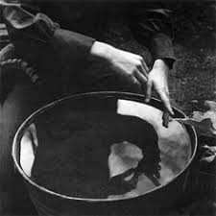
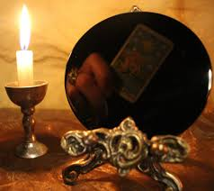
Themes – The Future
Famous Prophets, Psychics, and Seers.
→ Their Methods ←
Nostradamus: He used various methods. One of them was a divination method called scrying. Scrying involves staring into a mirror, a bowl of water, a crystal ball, or similar object to enter a trance and create a channel to conjure a spirit or supernatural entity asking them to provide a vision of the future. The Englishman John Dee (astrologer to Queen Elizabeth I) repeatedly used the method during his life to consult with angels.
Notes:
3 min.

Slide 13
Themes – The Future
Famous Prophets, Psychics, and Seers.
→ Their Methods ←
Nostradamus also used a very similar ritualistic method to that which Pythia, the Oracle of Delphi used. More specifically, he used an important object – a 3-legged stool (tripod made of brass) whose legs were angled at the same degrees as the Egyptian pyramids; the dimensions of the stool were thought to create an electromagnetic energy field that weakened the veil between this world and the supernatural world, thus more easily accessing the spirits or gods for divination. Put simply, he was creating a channel between himself and the divine (supernatural entities).
Notes:
3 min.

Slide 14
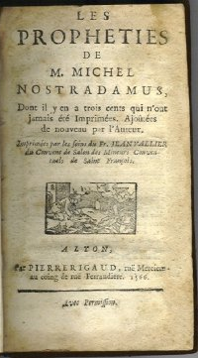
Themes – The Future
Famous Prophets, Psychics, and Seers.
→ Their Methods ←
Nostradamus – Prophecies
Nostradamus learned of many future events through his divination practices which resulted in him collecting them in a series of writings – the most famous being The Prophecies – and also in the form of letters he wrote to important people such as kings.
It was very dangerous in those days to use any kind of divination practice, as it was seen as magic and could be punishable by death. So, the French seer had to be very careful in his writings. He wrote his material in a cryptic (encoded) fashion to avoid being sent to prison or put to death by those in power.
He wrote most of his predictions in the form of short 4-line poems called Quatrains.
Notes:
2-3 min.

Slide 15
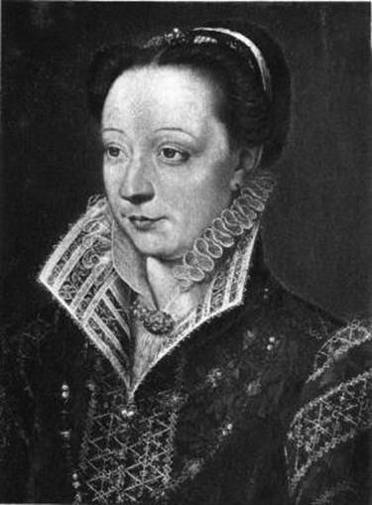
Themes – The Future
Famous Prophets, Psychics, and Seers.
→ Their Methods ←
Nostradamus – Prophecies
He wrote most of his predictions in the form of short 4-line poems called Quatrains.
Each quatrain, written predominantly in French, with some Latin, Greek and Italian, foretells a particular event or era.
In his lifetime, Nostradamus has completed a total of 942 quatrains which are organized into groups of 100 called “centuries”.
The centuries brought Nostradamus greater celebrity and attracted the attention of the French queen, Catherine de Medici, who called the seer to the royal court in 1556 for a consultation. The queen became an admirer and Nostradamus, also an astrologer, was later appointed court physician and asked to produce horoscopes for the seven royal children.
Queen Catherine de Medici
Notes:
2-3 min.

Slide 16
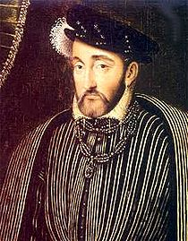
Themes – The Future
Famous Prophets, Psychics, and Seers.
→ Their Methods ←
Nostradamus – Famous Predictions:
One prophecy said to be of particular interest to Catherine de Medici was Quatrain 1.35, which was widely believed to predict the accidental death of her husband, King Henry II:
"The young lion will overcome the older on, On the field of combat in single battle; He will pierce his eyes through a golden cage, Two wounds made one, then he dies a cruel death."
Nostradamus had even written a letter to King Henry II describing what he had foreseen and that he shouldn’t engage in any duels in his 41st year. But the king didn’t heed his warning.
King Henry II of France
Notes:
3-4 min.

Slide 17
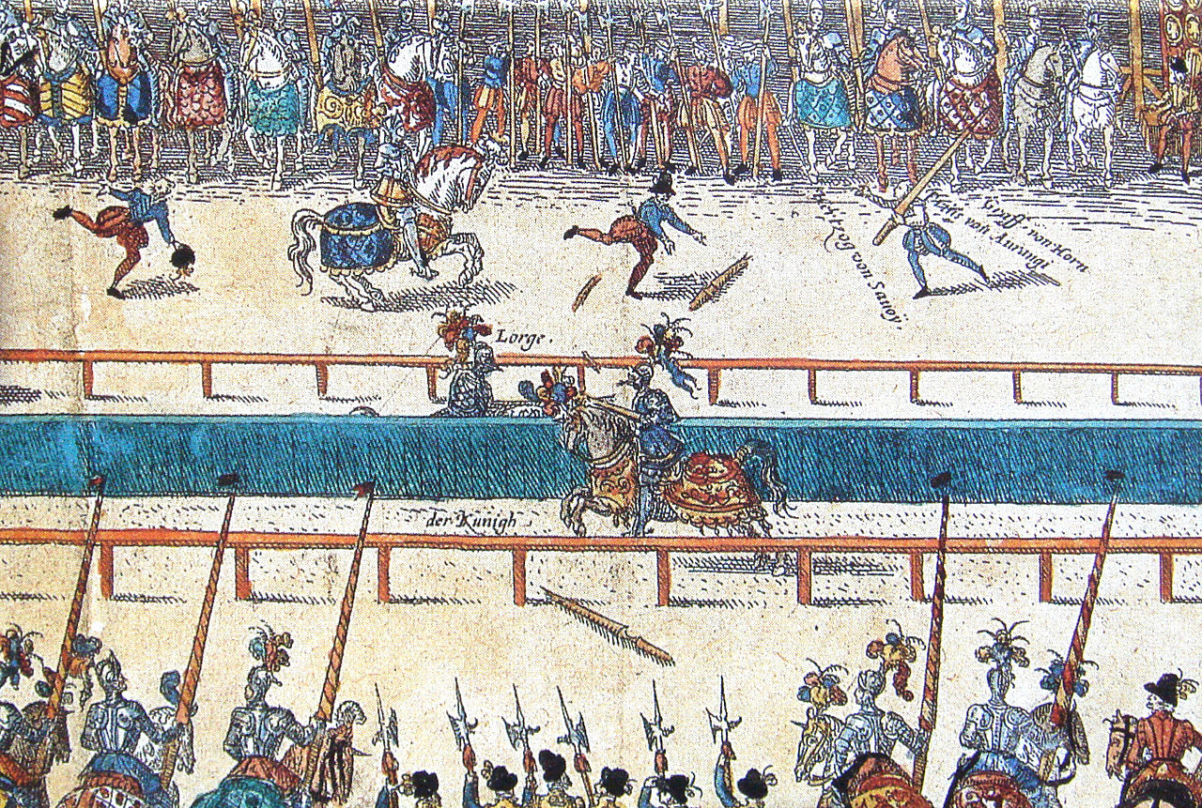
Nostradamus – Famous Predictions:
His prediction came true in 1559, when the king, in his 41st year, was killed in a jousting accident – from the injury sustained on his eye.
Notes:
2-3 min.
Image source and info: https://en.wikipedia.org/wiki/Henry_II_of_France

Slide 18
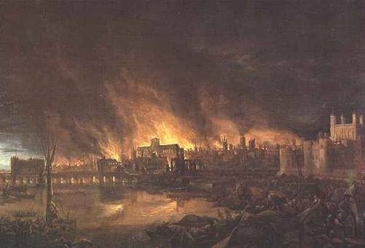
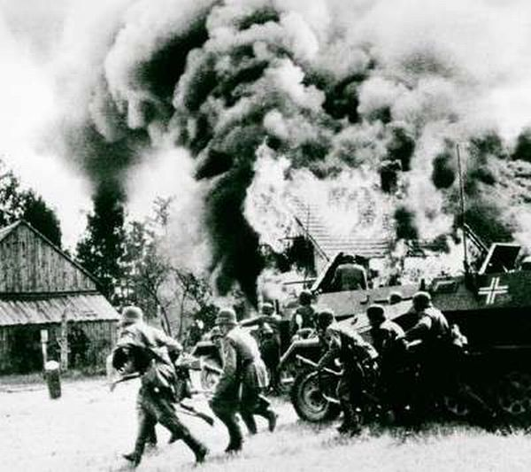
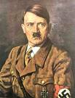
Nostradamus – Famous Predictions:
The Fire of London in 1666
In this prophecy Nostradamus predicted the exact year a great fire would destroy a large part of London. His quatrain (Century 2; Quatrain 51) read:
“The blood of the just will be demanded of London, Burnt by the fire in the year 66.”
The Rise of World War II and Hitler
In several quatrains, Nostradamus foresees the rise of Hitler, the German empire and WWII. Two key quatrains read:
- “From the deepest part of Western Europe A young child will be born to poor people Who will by his speech seduce a great multitude, His reputation will increase in the Kingdom of the East”
- “Beasts ferocious with hunger will cross the rivers, The greater part of the battlefield will be against Hister. Into a cage of iron will the great one be drawn, When the child of Germany observes nothing.”
Great file of London, 1666
Hitler & start of WWII
Notes:
4-5 min.

Slide 19
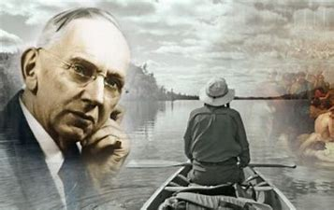
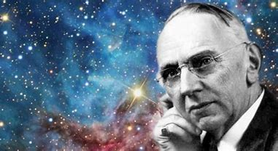
Themes – The Future
Famous Prophets, Psychics, and Seers.
→ Their Methods ←
Edgar Cayce: In his home, for his “readings” (for which he did not charge money) he would lay down and enter a sleep-like trance, or meditative state. Unlike with prayer (where one talks to God), Case believed God talks back through deep meditation. His secretary would read questions to him while in this state and she would record the answer he received. After the sessions, Cayce would not be able to recall what he had said.
Notes:
2-3 min.

Slide 20
Themes – The Future
Famous Prophets, Psychics, and Seers.
→ Their Methods ←
DISCUSSION QUESTIONS:
Do you think Pythia really existed or might simply have been a myth?
What similarity do the three seers share in their methods?
Do you think they each communicated with one or more supernatural beings to obtain their visions of the future? Could this be possible?
Edgar Cayce theorized that the unconscious mind had access to all kinds of information the conscious mind didn’t. What do you think about this theory? What do you think can be found there?
Notes:
8-10 min.

Slide 21
Themes – The Future
Famous Prophets, Psychics, and Seers.
What is reality?
Do you agree or disagree with this statement by Cayce?
Can our subconscious minds have thoughts?
If so, could they create “realities”?
Notes:
3-4 min.

Slide 22
Chapter 7 – The Renewal
Story Resolution & Discussion
This chapter concludes the tale and adventure of Amanita. On her journey, Amanita has been through many ordeals and has managed not only to heal and survive, but also grow and evolve.
FINAL DISCUSSION QUESTIONS:
Why did Amanita say “I’m ready.” at the very end of the story? What did she mean by this? Ready for what?
Also, as she finally opened her eyes to speak, it is noted that her eye color is of emerald green; yet, in chapter one her eye color is described as hazel. What do you think happened for this seemingly impossible phenomenon to occur? What could explain or be the meaning of this?
Notes:
4-6 min.

Slide 23
Chapter 7 – The Renewal
Story Resolution & Discussion
FINAL DISCUSSION QUESTIONS:
How might have Amanita’s physical ordeals changed her?
How may have Amanita’s slumber and dreams changed her?
What do you think Amanita did after she awoke in the woodsman cabin? Where might she have gone to?
What can the woodsman represent or symbolize?
What is the moral or message of the story?
Do you think it would be interesting to see a short film based on this story?
If there were to be a sequel – Amanita 2 – what could the subsequent story be about? Where would it take place? What may happen?
Notes:
10-12 min.

